Slide 1
Food Ordering App

Slide 2
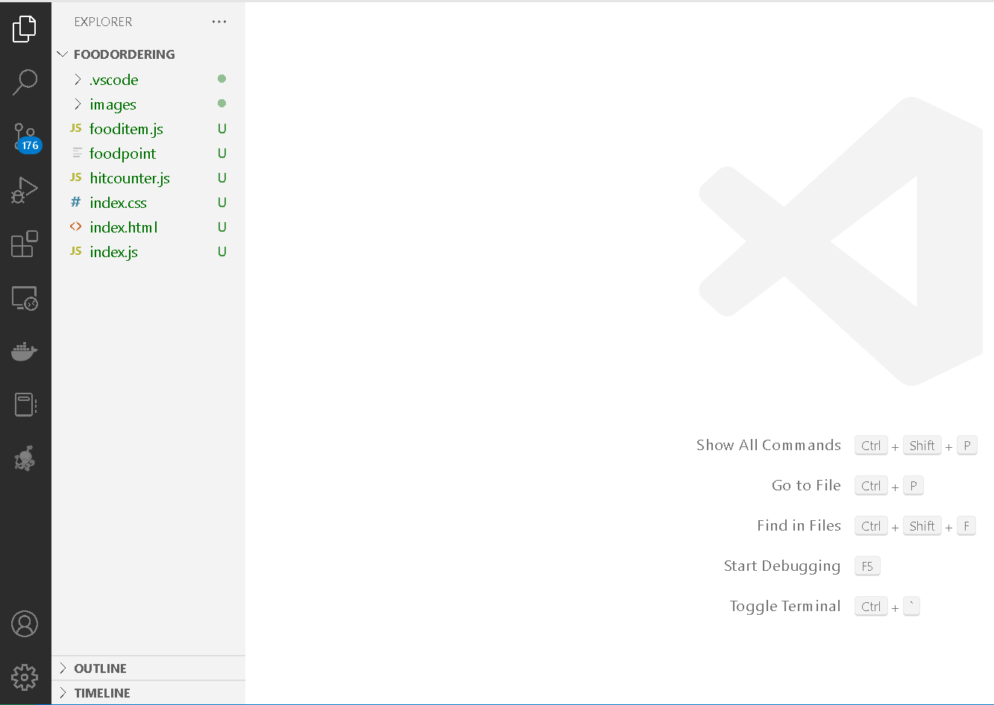
The project structure

Slide 3
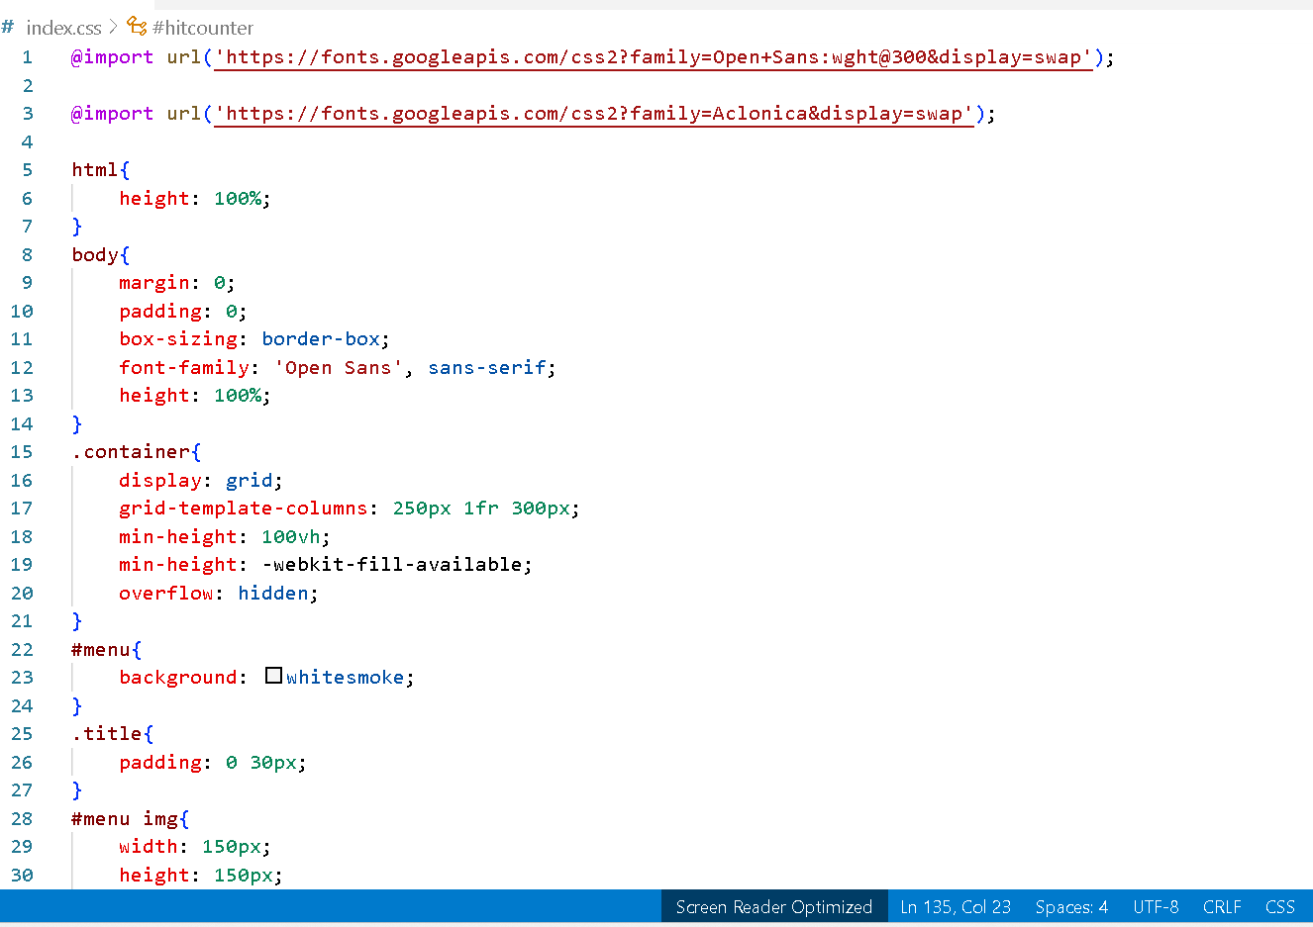
index.css

Slide 4
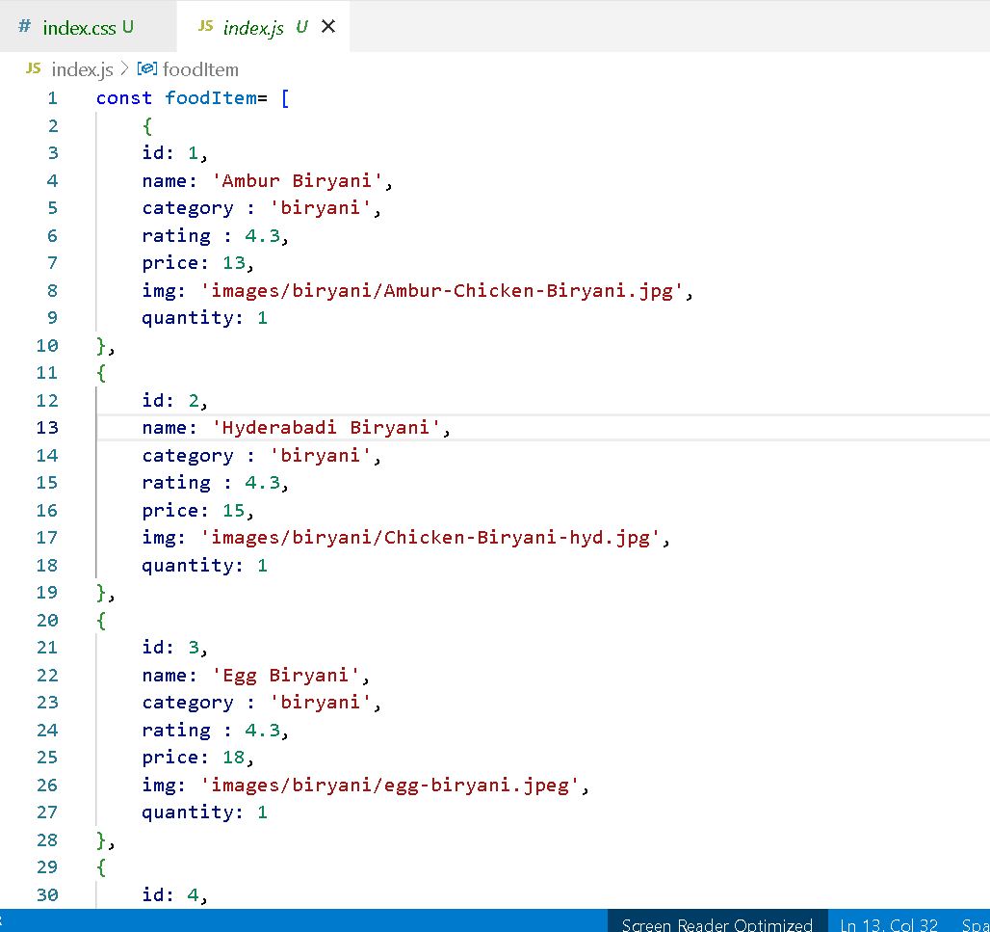
index.js

Slide 5
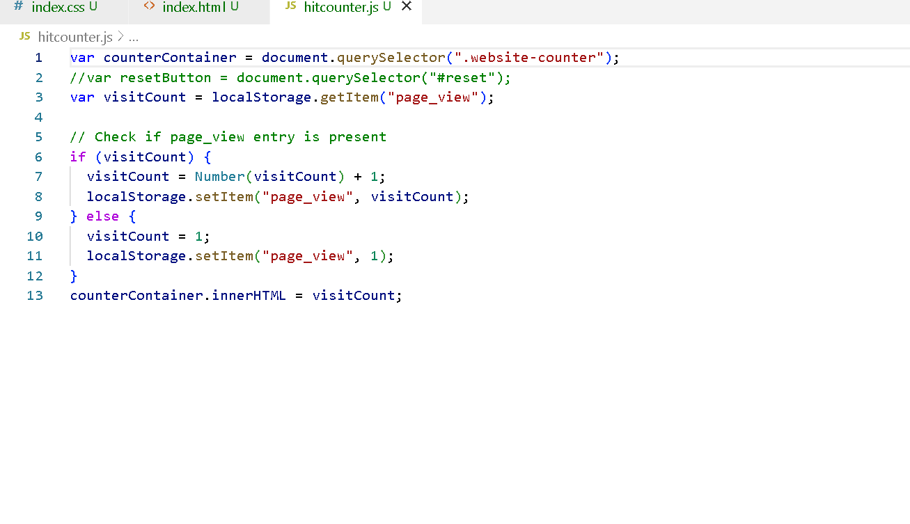
hitcouter.js

Slide 6
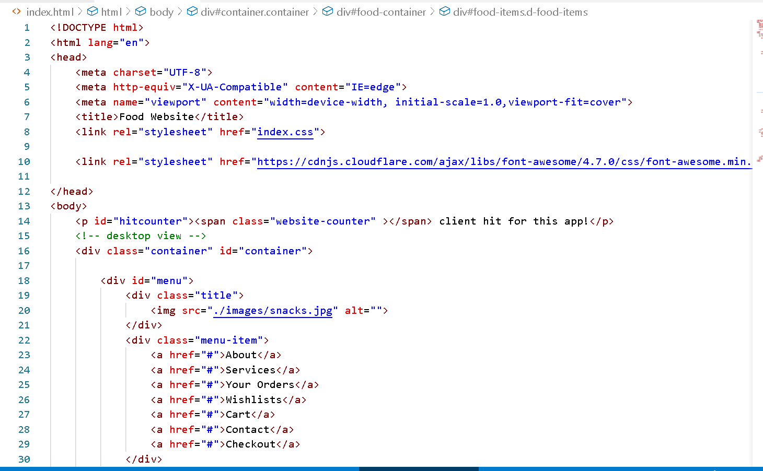
index.html

Slide 7
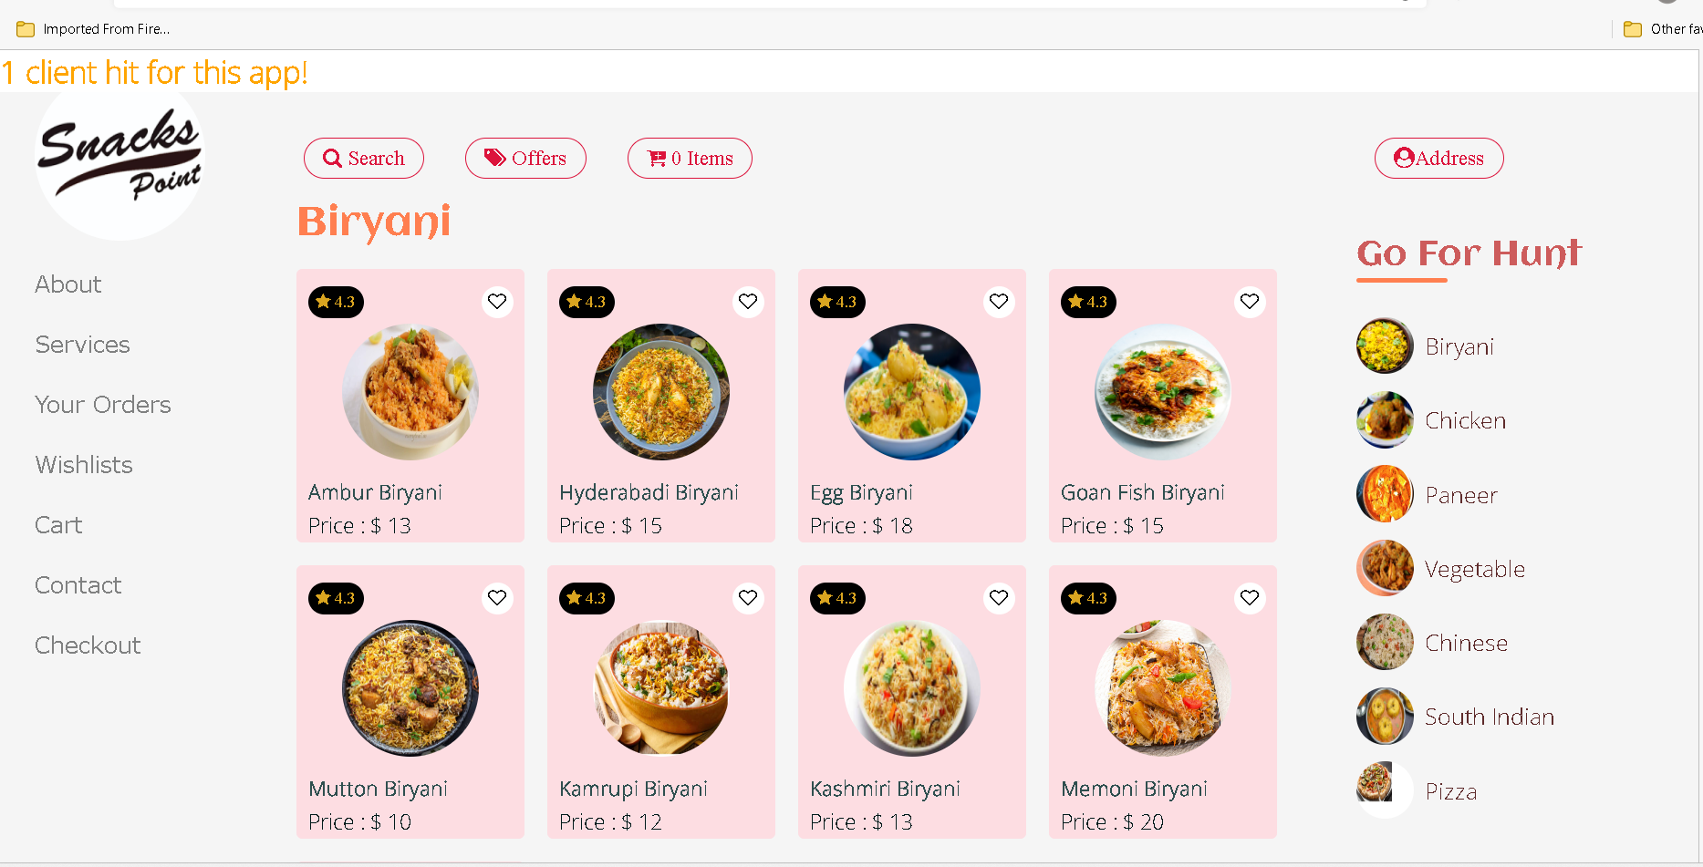
Run the index.html page

Slide 8
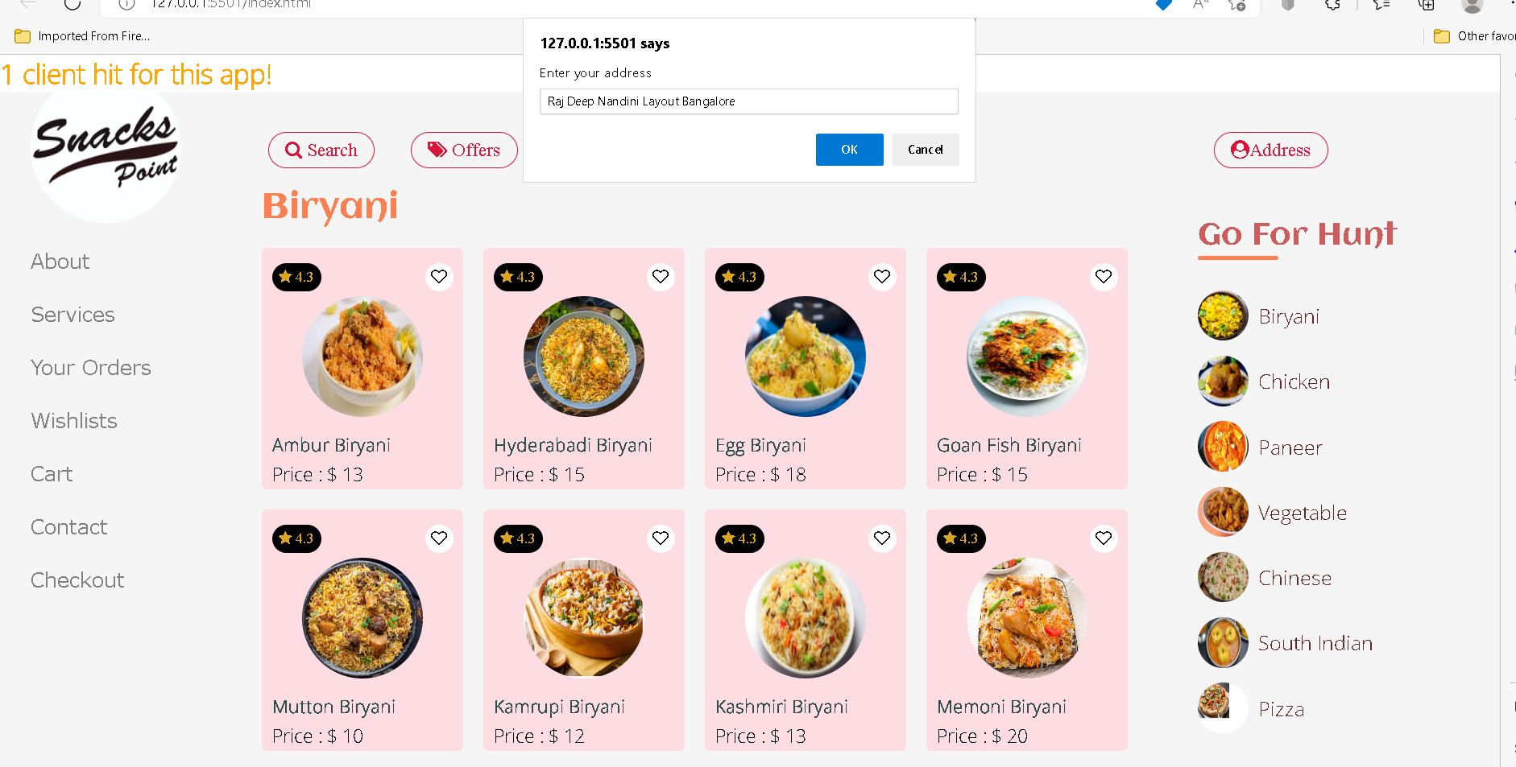
You can see only one client access this app
Now you can add the address. This details hold for temporary purpose.

Slide 9
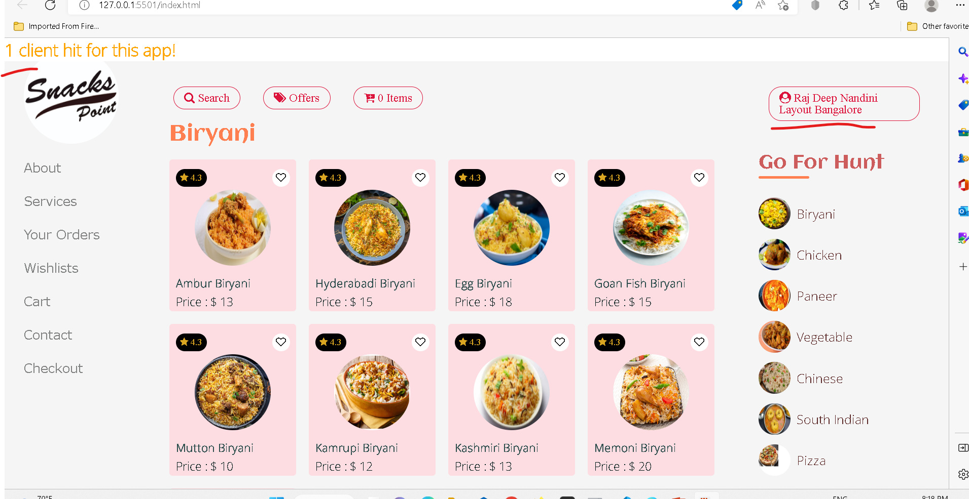
After added address

Slide 10
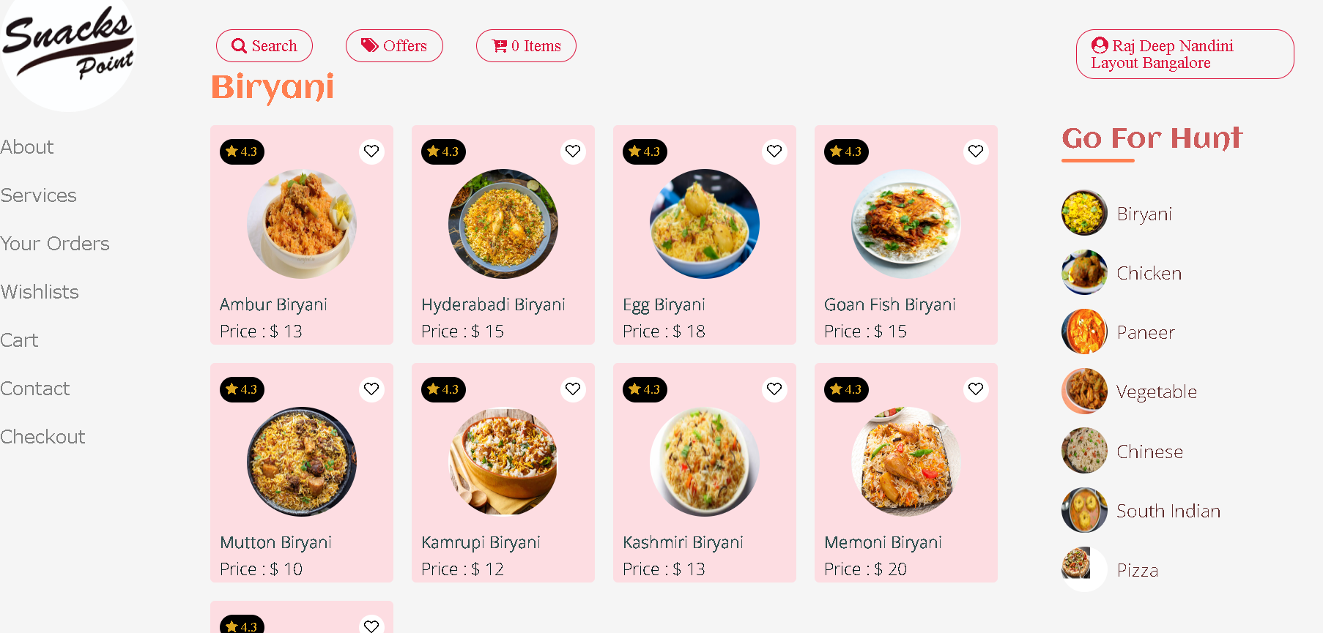
Now search item from category

Slide 11
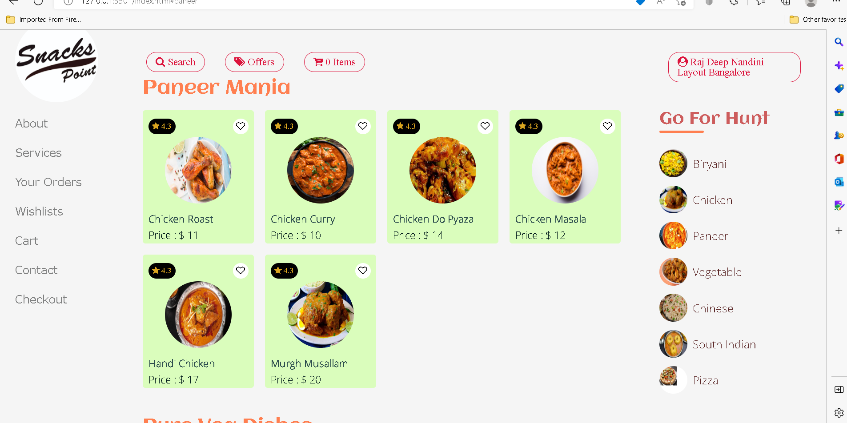
After selected paneer category

Slide 12
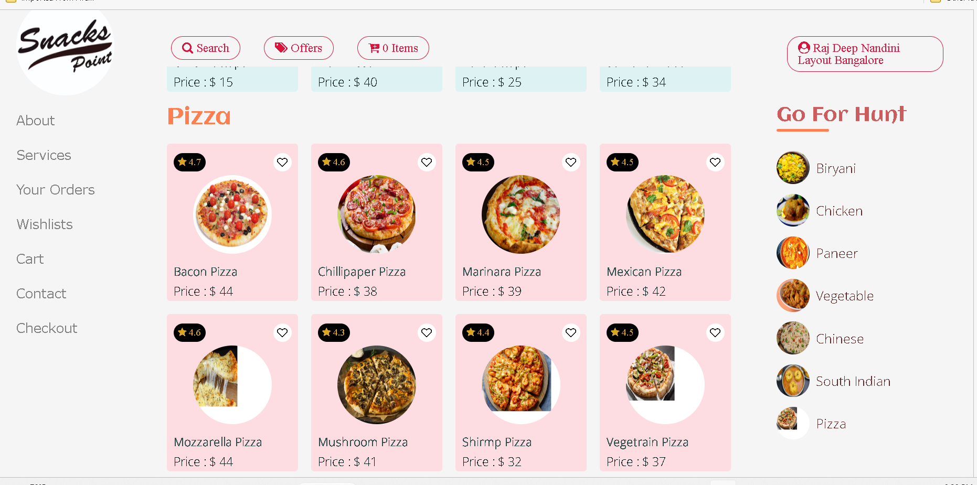
After selected pizza category

Slide 13
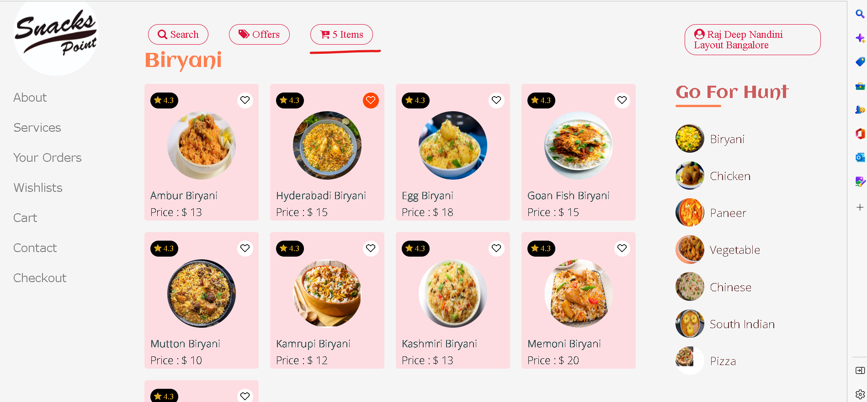
Now add item in wish list

Slide 14
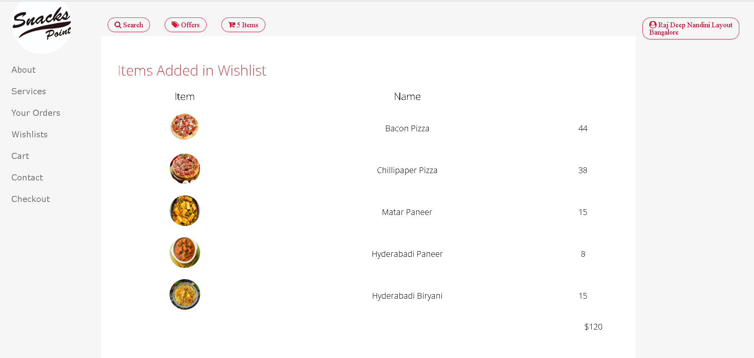
Now you can view all item present in cart

Slide 15
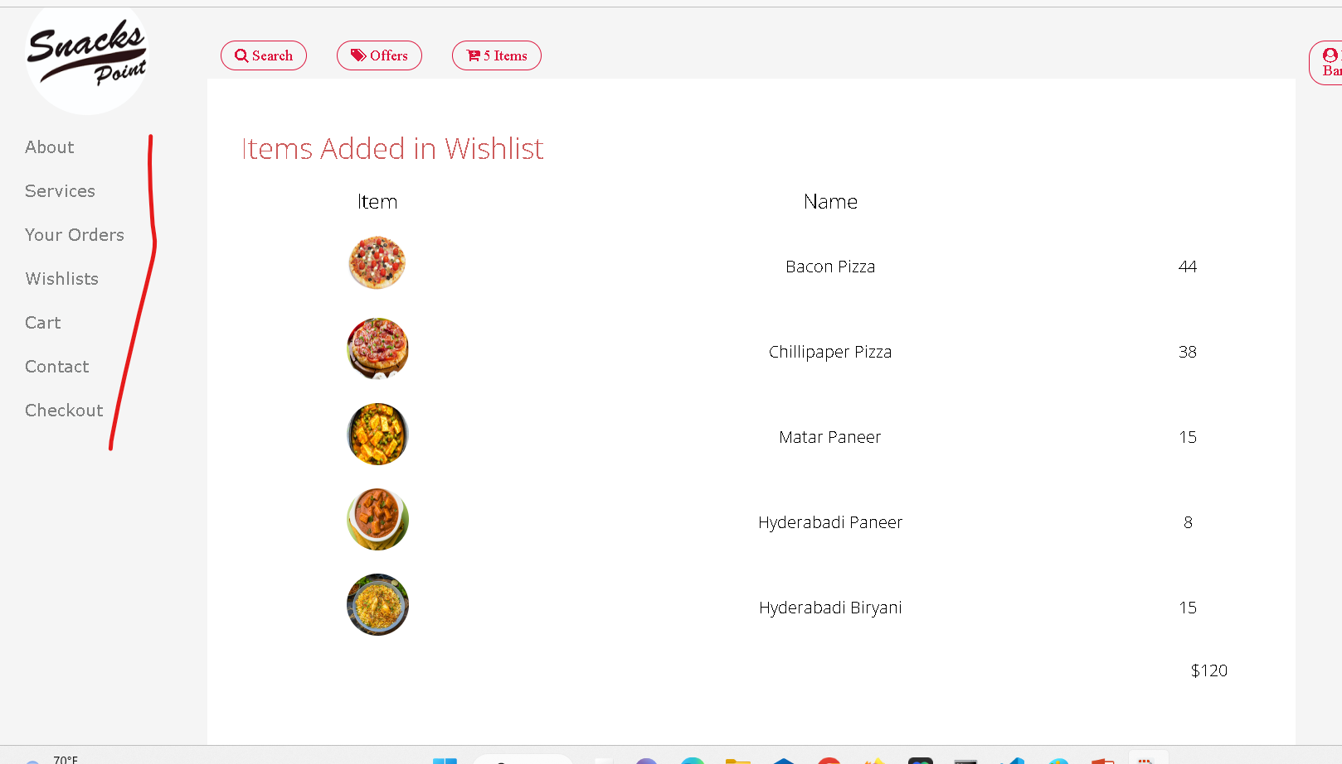
Other link are dummy

